Slide 1

ENGLISH PRESENTATION ON STACKOVERFLOW PROBLEM
Running multiple SSH commands in a script

Slide 2
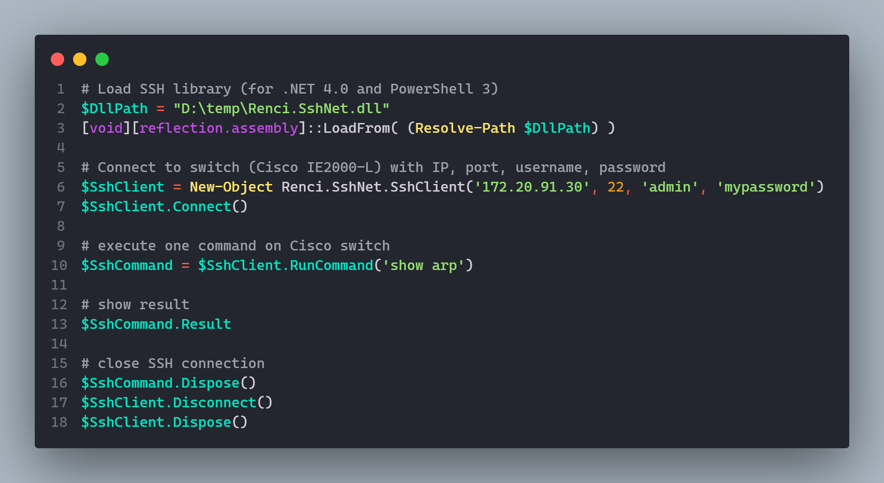

DEFECTIVE PROGRAM CODE

Slide 3
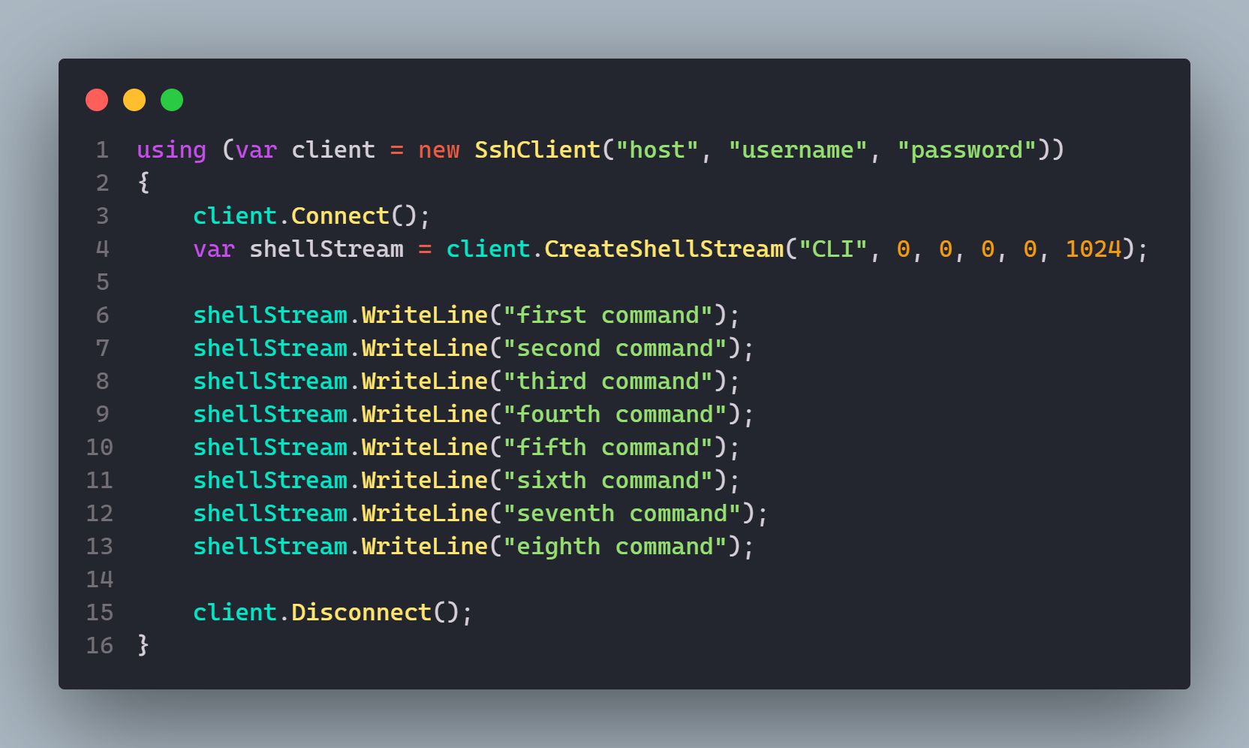
OUR SOLUTION

Slide 4


THANK YOU FOR LISTENING TO US !

